Slide 1
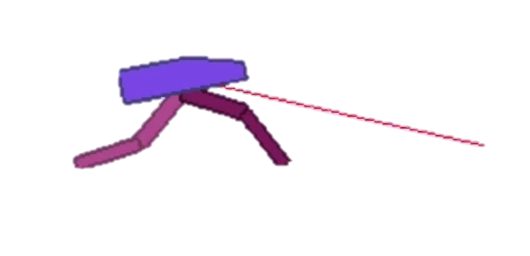
Bipedal Walker
Customizing OpenAI Gym Environments and Implementing Reinforcement Learning Agents with Stable Baselines
Work done by:
Guilherme Oliveira up202204987
Magda Costa up202207036
Pedro Silva up202205150

Slide 2
ENVIRONMENT
STATES:
REWARDS:
The state is a continuous vector of 24 dimensions wich include:
Angle and angular velocity of the hull (main body): 2 points.
Horizontal and vertical hull speed: 2 points.
Joint angles and leg angular velocities: 8 points (4 joints x 2 points each).
Ground contact sensors on the legs: 2 values ​​(indicating whether each leg is in contact with the ground).
Information on the terrain ahead (LIDAR sensors): 10 points (terrain readings to anticipate obstacles).
Reward is given for moving forward, totalling 300+ points up to the far end. If the robot falls, it gets -100. Applying motor torque costs a small amount of points.
PERCEPTS:
The agent sees everything it needs to (state = perceptions), as the environment is fully observable, eliminating the need to infer hidden information or deal with noise.
ACTIONS:
Actions are motor speed values in the [-1, 1] range for each of the 4 joints at both hips and knees.

Slide 3
REWARDS
In the project we experimented with different types of rewards, in different parts of its development, and the rewards that were implemented were as follows:
REWARDS:
PENALTIES:
- Alternate feet
- Overcome steep terrain
- Moving forward
- Lifting its legs from the ground
- Using each leg the same number of times
- Vertical sudden moves (ex: falling)
- Severe instability (ex: torso inclination)
- Stands still for a long time or stops moving
- Agent fails

Slide 4
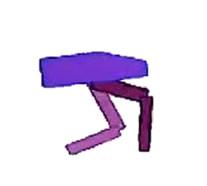
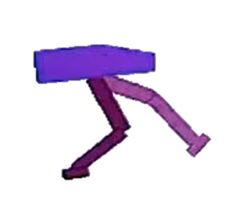
AGENT COSTUMIZATIONS
We decided to try implementing ankles on the agent, in order to try and figure out whether or not giving it 'feet' would be advantageous. To achieve this, we added two joints to the agent, therefore creating feet.
Normal Agent
Costumized Agent

Slide 5
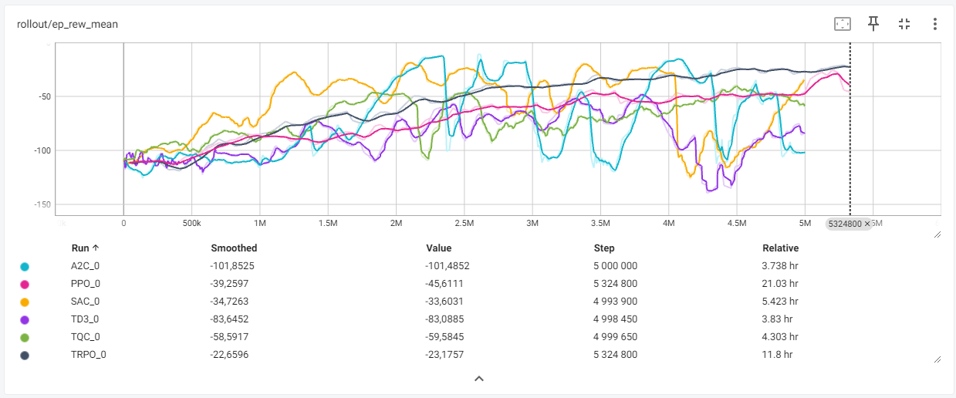
Chosen RL algorithms

Slide 6
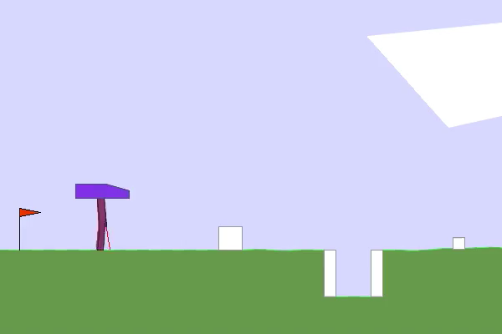
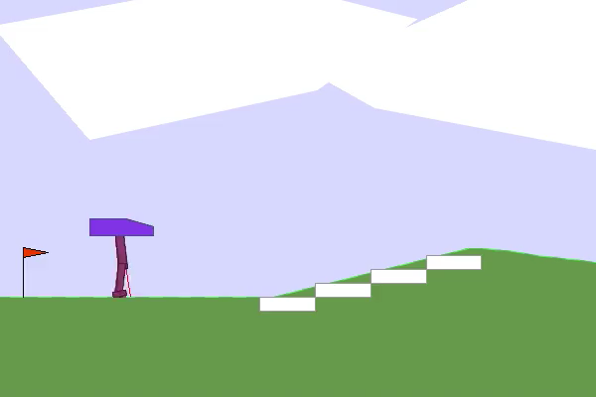
FIRST PHASE
Initially, we decided to test small rewards to understand the impact each of them had and whether their use was justified or not, having trained the models with 30M timesteps.
TEST 1:
TEST 2:
- Overcome steep terrain
- Vertical sudden moves (ex: falling)
- Severe instability (ex: torso inclination)
- Alternate feet
- Vertical sudden moves (ex: falling)

Slide 7
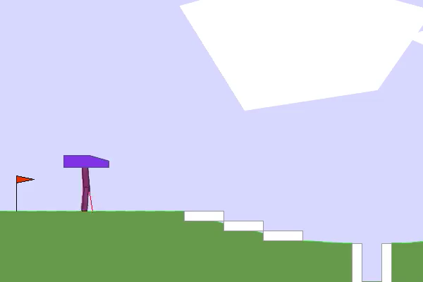
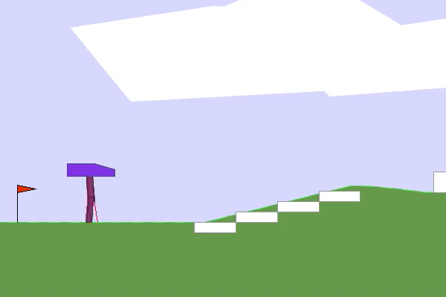
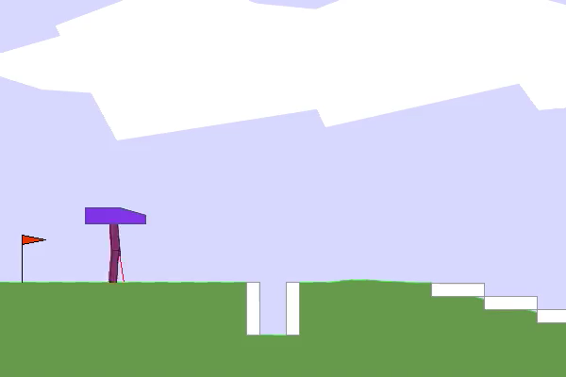
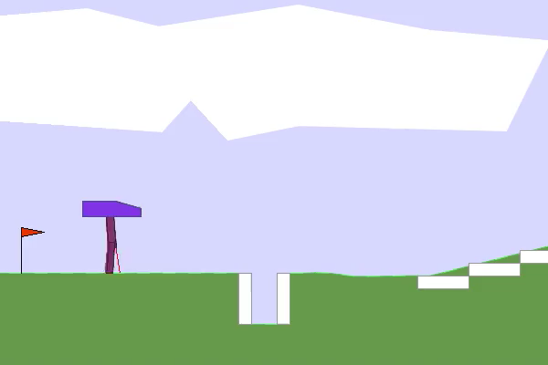
SECOND PHASE
After detecting the initial errors, we realized that we should encourage the agent to walk forward and remove the alternating use of both feet.
TEST 1:
- Overcome steep terrain
- Vertical sudden moves (ex: falling)
- Severe instability (ex: torso inclination)
- Moving forward
- Stands still for a long time or stops moving
- Agent fails
PPO
TRPO
Analysing the videos we noticed that the agents' performance improved significantly. However, in some cases, agents had problems overcoming holes and blocks.
SAC
CONTROL - SAC

Slide 8
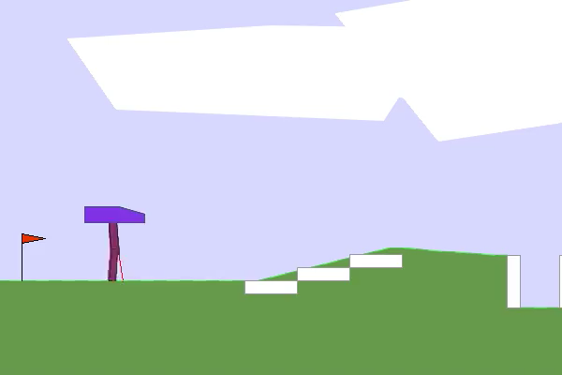
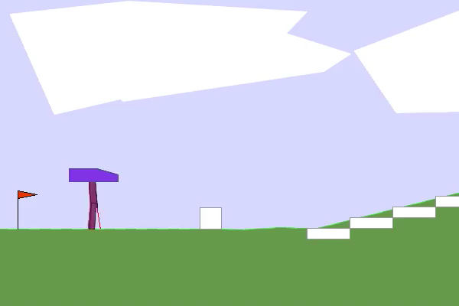
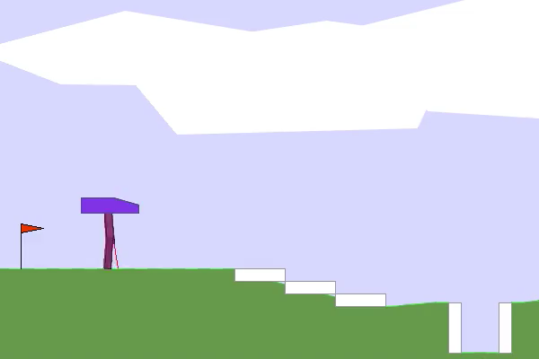
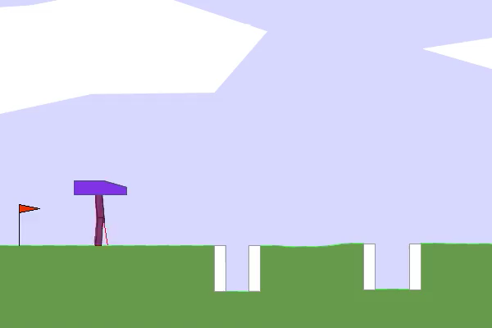
THIRD PHASE
In an attempt to further improve the second phase, we decided to do a third test by changing the rewards again and truing to correct the minor errors detected in the previous phase.
TEST 1:
- Overcome steep terrain
- Vertical sudden moves (ex: falling)
- Severe instability (ex: torso inclination)
- Moving forward
- Stands still for a long time or stops moving
- Agent fails
- Lifting its legs from the ground
- Using each leg the same number of times
PPO
TRPO
SAC
CONTROL - TRPO

Slide 9
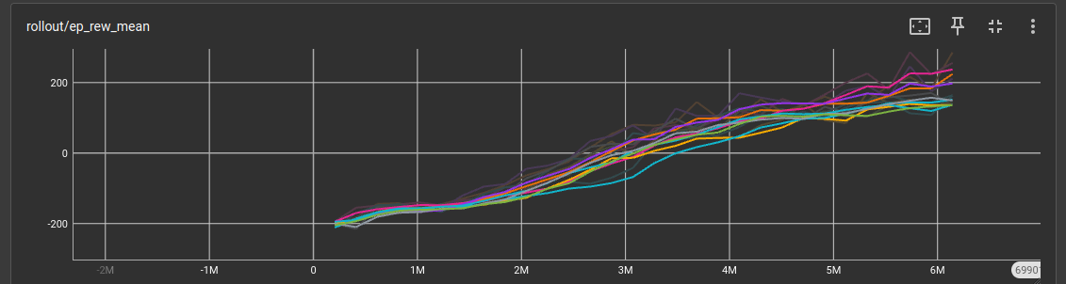
OTHER TESTS
FEET VS NO FEET:
Hyperparameter Tunning:
Initially we did some tests with and without feet without any changes to the original rewards to see if there were any major differences, which is how we concluded that using feet is not exactly advantageous.
At the end of the project, we tried to use phase 3 rewards to see if they were capable of improving the feet. By doing a test on its performance we concluded that their use did not really present any advantages either.
We chose the best hyperparameters based on Value, and then used the winner to train TRPO, which was the worst in phase 2. (learning rate = 0,0005, batch size = 64, gamma = 0,99)
After comparing the performances with and without Hyperparameter tunning we realized that without HP we have an average reward of around -27 and with, around 8, so we already see a big improvement, despite only being with 10M timesteps.
Note: This test was made using phase 3 rewards.
Note: This test was made using phase 2 rewards.

Slide 10
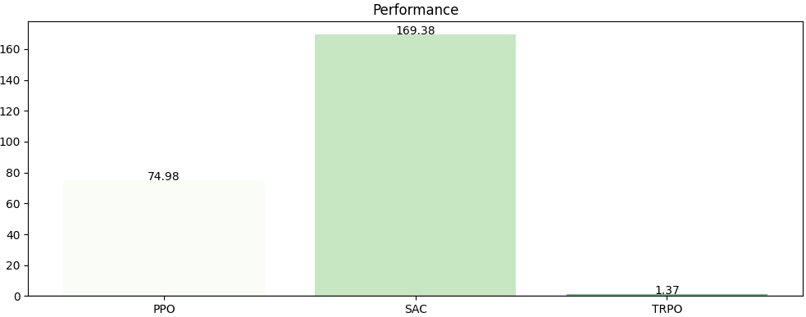
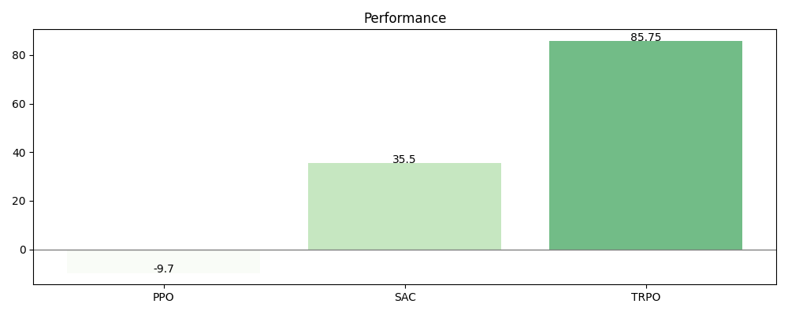
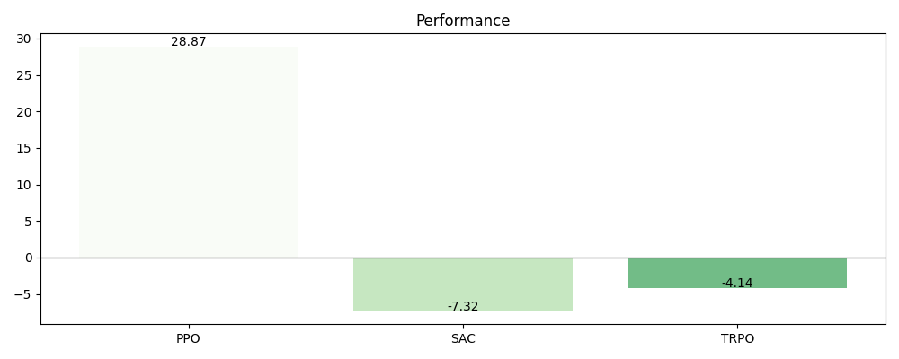
Phase 2:
The graphs presented here correspond to the final tests (phases 2 and 3) and the original environment. We concluded that of the changes we made, the use of feet proved to be completely irrelevant, and their use even harmed the models. The use of hyperparameter tuning proved to be very advantageous, having exponentially improved the tested model. Finally, taking into account the rewards we used, we came to the conclusion that both rewards allowed us to obtain better results than when they are not used, and those in phase two proved to be the best.
Phase 3:
Original Environment:

